Slide 1
NYC Public High Schools
Shiny project presentation
Yisong Tao
10-30-2016

Slide 2
What does the app do?
Provide information about New York City’s public high schools
School districts
School locations
Admission Priority
SAT scores 2010 and 2012
NYC school survey 2011
Number of Students 2016
Other info: website, contact, school programs, etc.
Interface - 3 tabs
Interactive Map
School info
School District Comparison

Slide 3
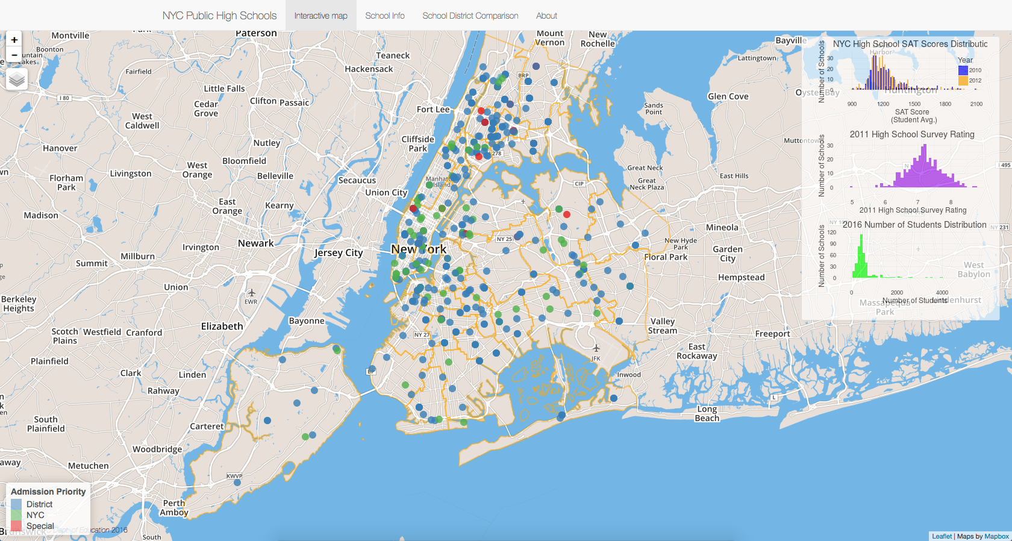
https://yisongtao.shinyapps.io/NYC_HS/

Slide 4
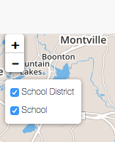
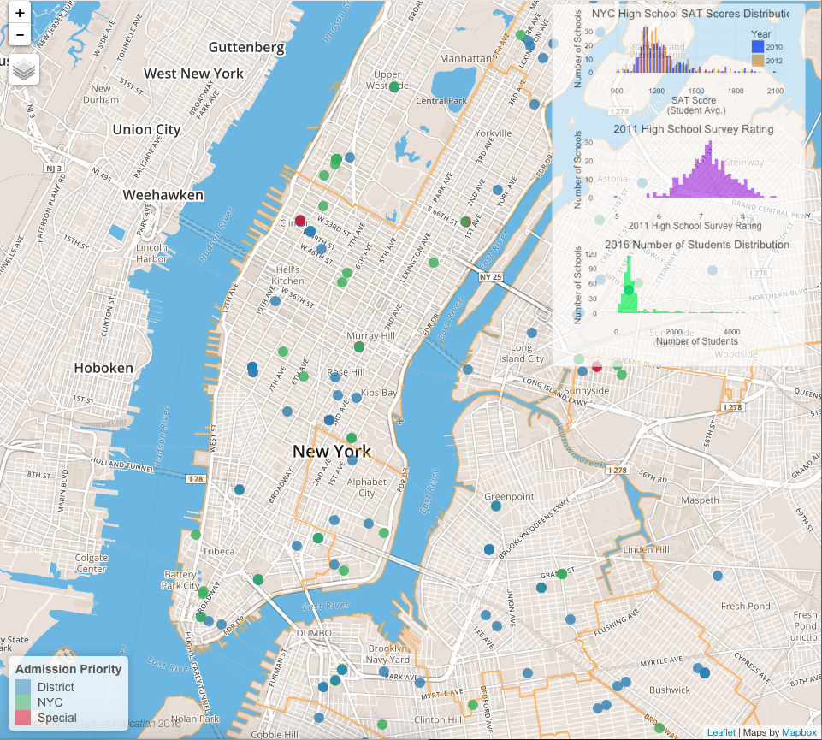
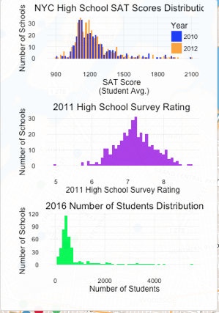
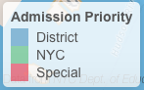

Slide 5
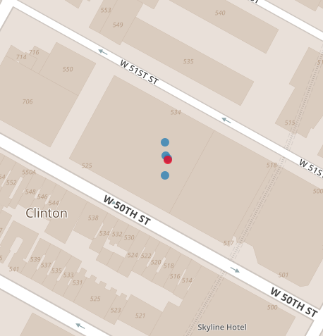
437 public high schools, 258 campuses
Some campuses host as many as 6 schools
Used Jitter() when drawing school locations

Slide 6
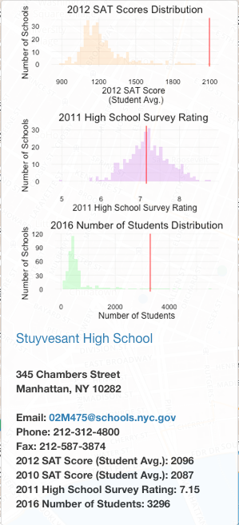
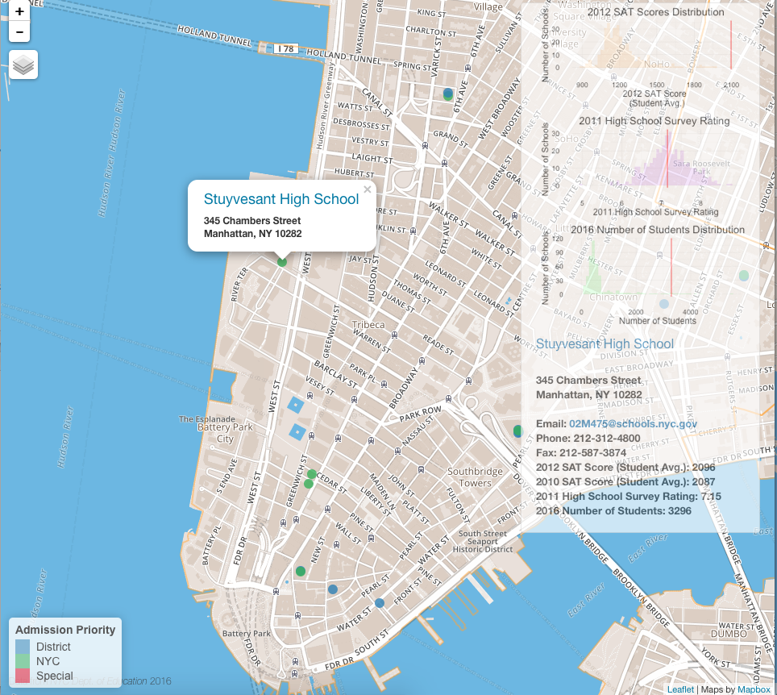
Click on a school on map: a pop up will display school name and address;
the side panel will also be updated some school info.
Click on map will remove the pop up and change the side panel back.

Slide 7
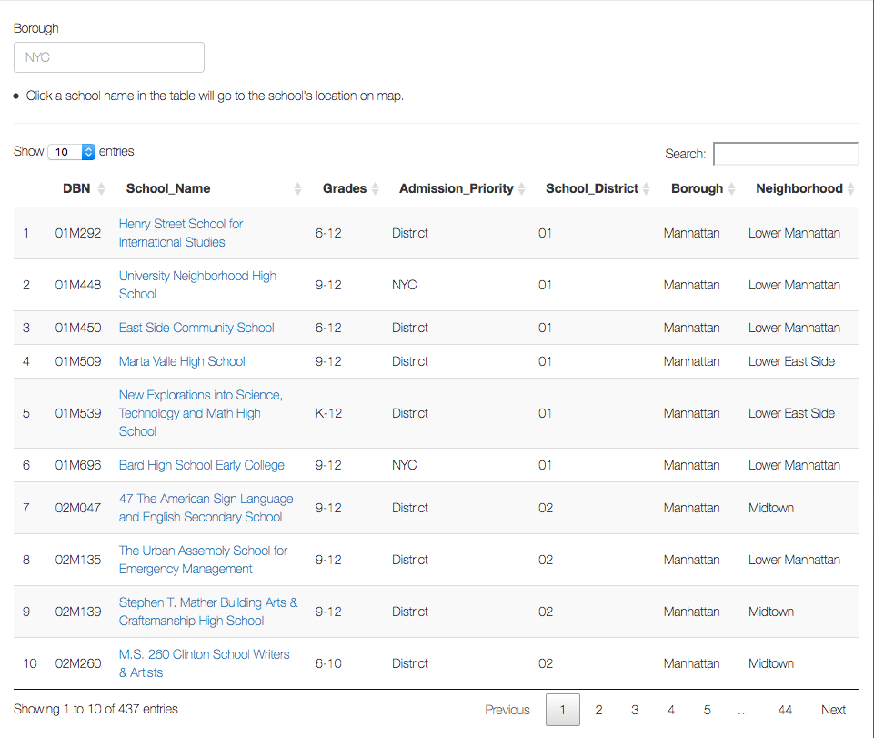
School info tab

Slide 8
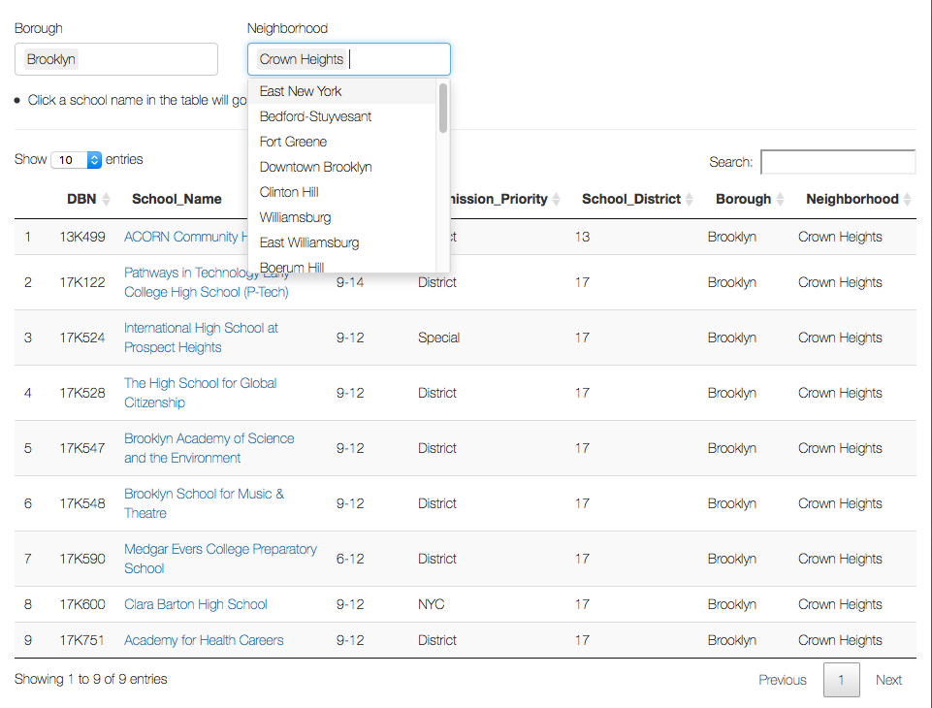
First filter by borough name
Then the second filter box will show up, the neighborhood names in the list is already filtered by borough chosen.
The entries in the table will be filtered accordingly.

Slide 9
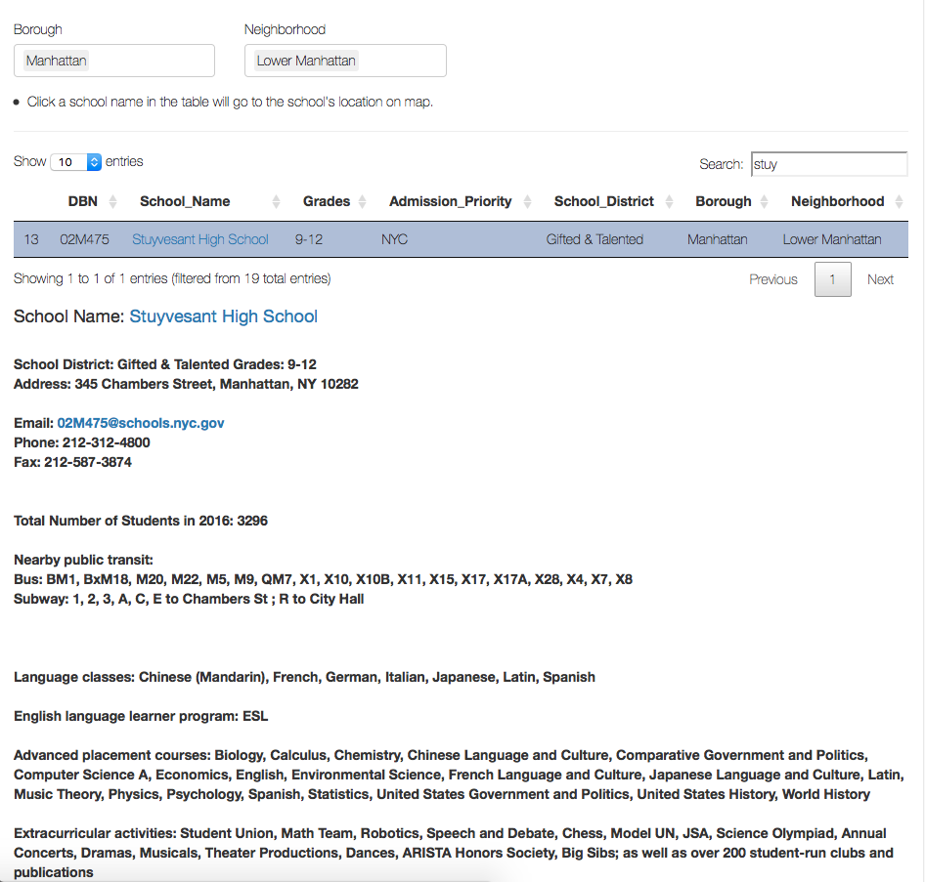
Select a row in table and more info about the school will be displayed below the table.

Slide 10
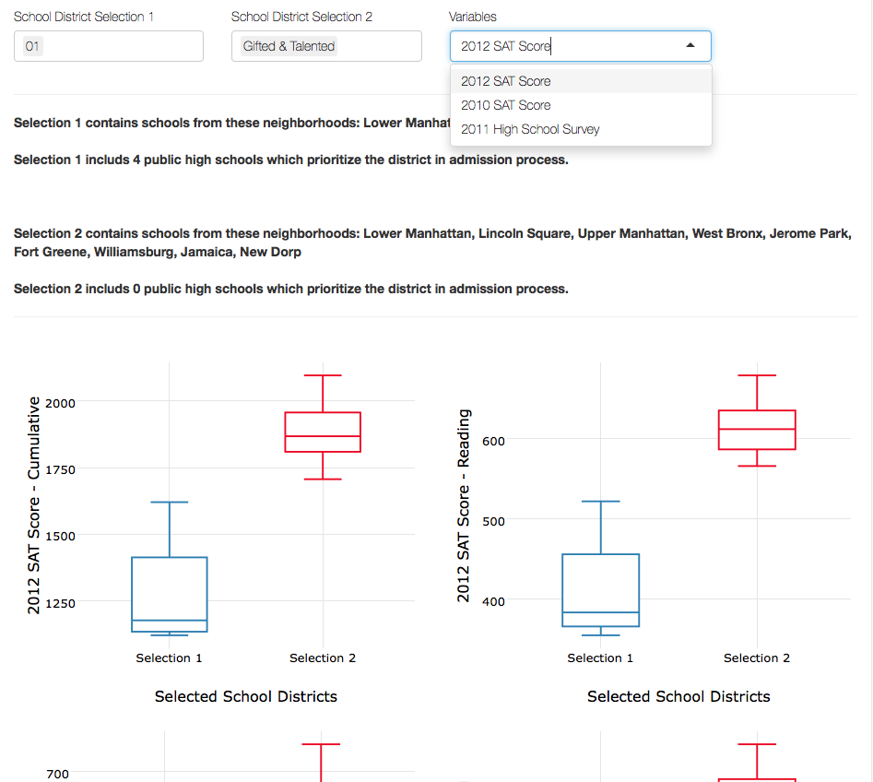
School District Comparison tab:
Select 2 sets of school districts and compare them on boxplots
NYC has 32 school districts, the choice list contains the 32 school districts and “Gifted & Talented”, which is NYC’s most selective public schools.
The choice list of second selection box will filtered against the choices in the first box.
The third box gives choices for the variable to compare: 2012 SAT score, 2010 SAT score or 2011 school survey.

Slide 11
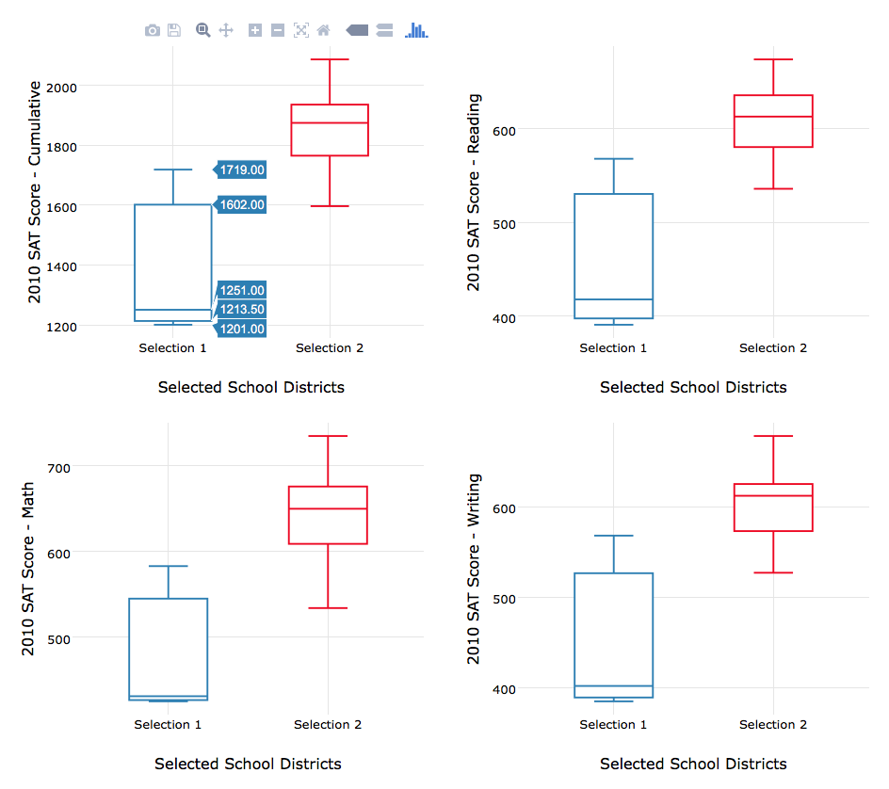
Comparing SAT score between school districts:
Cumulative, Reading, Math and Writing
Plots are rendered with “plotly”,
mouse over the plots will show more details of the box plots.

Slide 12
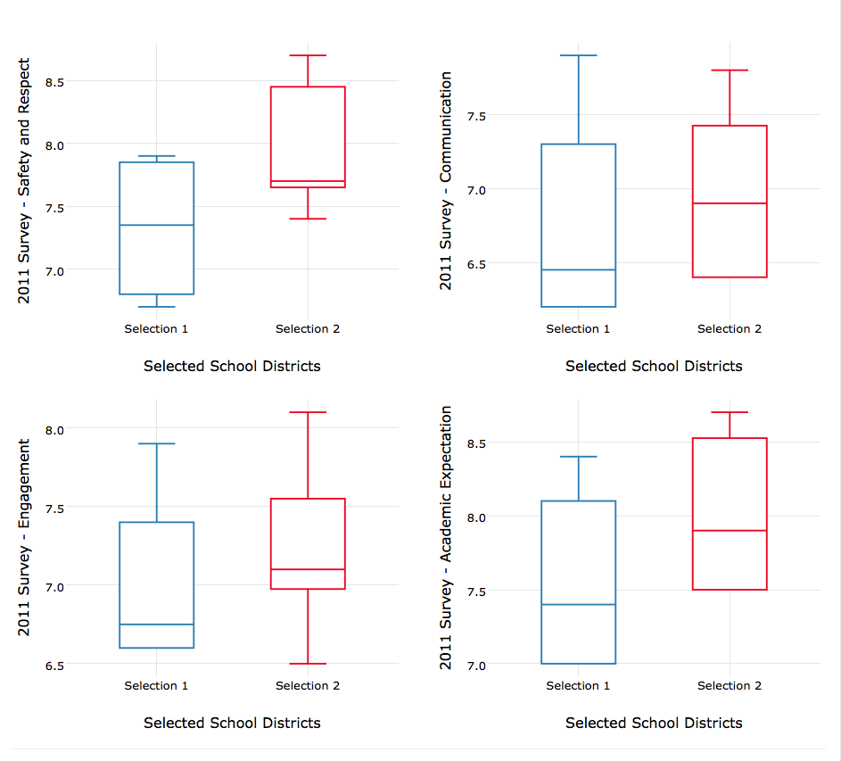
If you choose to compare 2011 school survey results,
The results in 4 aspects: Safety and Respect, Communication, Engagement and Academic Expectation.

Slide 13
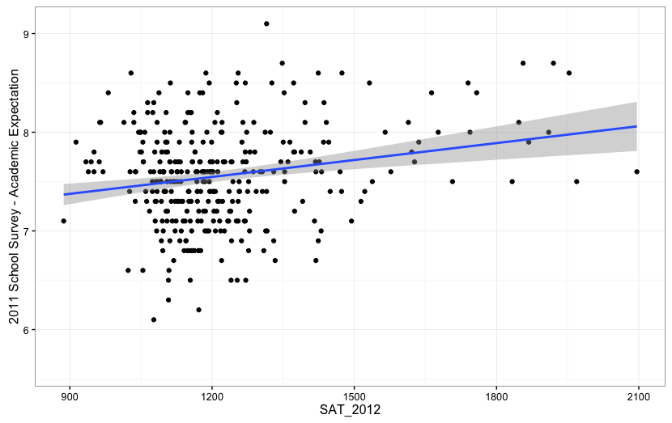
Understanding the school survey rating:
School survey is subjective,
a “review”, it reflects how well the school meets the reviewers’ expectations.

Slide 14
Thank you!

